Slide 1
Regression Analysis
Multiple Linear Regression
Nicoleta Serban, Ph.D.
Professor
School of Industrial and Systems Engineering
Model Interpretation

Slide 2

About This Lesson

Slide 3
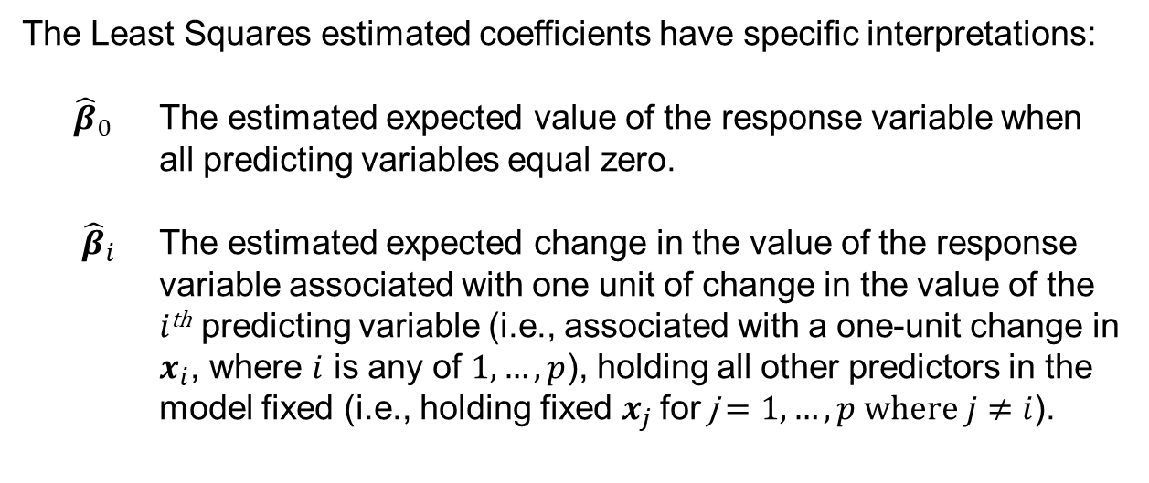
Model Interpretation: Parameters
The Least Squares estimated coefficients have specific interpretations:
${\hat{β}}_{0}$ The estimated expected value of the response variable when all predicting variables equal zero.
${\hat{β}}_{i}$ The estimated expected change in the value of the response variable associated with one unit of change in the value of the $i$^{th} predicting variable (i.e., associated with a one-unit change in $x_{i}$, where $i$ is any of $1,…,p$), holding all other predictors in the model fixed (i.e., holding fixed $x_{j}$for j $=1,…,p where j≠i$).

Slide 4
Model Interpretation: Simple vs. Multiple Regression
Marginal versus conditional relationship:
Marginal Simple linear regression captures the association of a predicting variable to the response variable marginally, i.e., without consideration of other factors.
Conditional Multiple linear regression captures the association of a predicting variable to the response variable conditionally, i.e., conditional of all other predicting variables in the model.
The estimated regression coefficients for conditional and marginal relationships can differ not only in magnitude but also in sign or direction of the relationship.

Slide 5
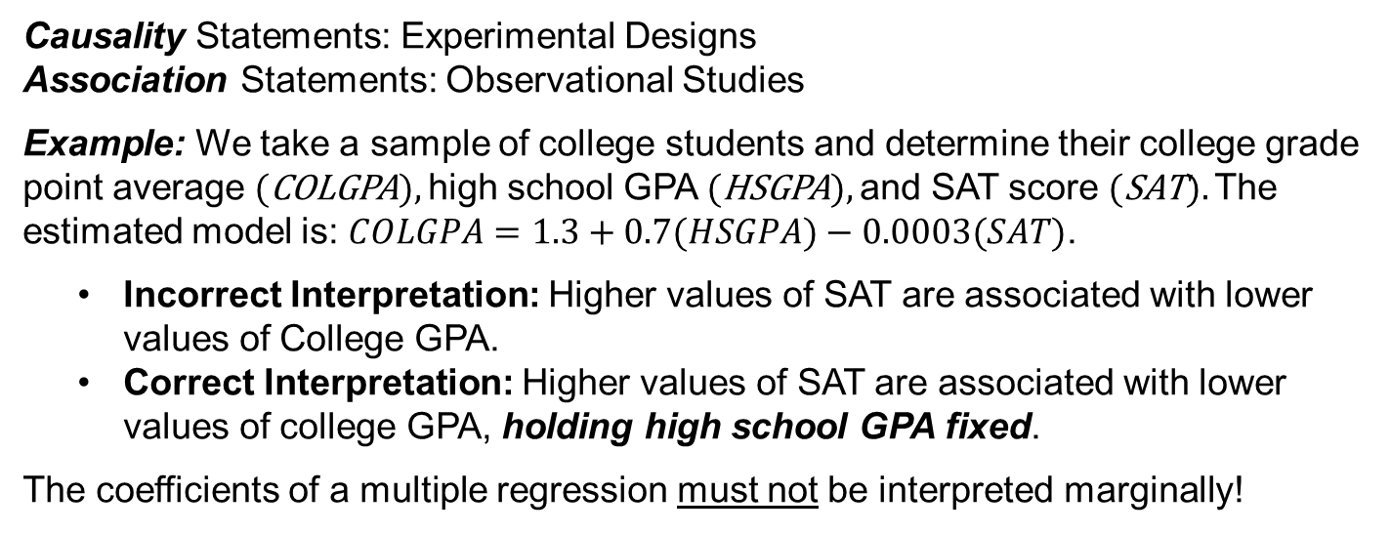
Model Interpretation: Causality vs. Association
Causality Statements: Experimental Designs
Association Statements: Observational Studies
Example: We take a sample of college students and determine their college grade point average (COLGPA), high school GPA (HSGPA), and SAT score (SAT). The estimated model is: $COLGPA=1.3+0.7(HSGPA)−0.0003(SAT)\text{.}$
    Incorrect Interpretation: Higher values of SAT are associated with lower values of College GPA.
    Correct Interpretation: Higher values of SAT are associated with lower values of college GPA, holding high school GPA fixed.
  The coefficients of a multiple regression must not be interpreted marginally!

Slide 6
Different Roles of Predicting Variables
Predicting variables can be distinguished as:
Controlling – to control for bias selection in the sample. They are used as ‘default’ variables in order to capture more meaningful relationships.
Explanatory – to explain variability in the response variable. They may be included in the model even if other “similar” variables are in the model.
Predictive – to best predict variability in the response regardless of their explanatory power.

Slide 7
About This Lesson

